Slide 1
SE361 – Sprint #1 Review
Anna Vadella, Elijah Heslop, Garret Blake, Kwesi Kyei-fordjour, Daniel Field
Red Agents

Slide 2
Group Introductions
In our Sprint #0 Presentation, we did not properly introduce ourselves – so now we will each go around and say our name and our role within the group.

Slide 3
Tables of Contents
1
2
3
4
Goals for Sprint
Updated User Stories
Outline of the goals we intended to complete this sprint, ranked by difficulty
More in-depth User Stories, compared directly with our User Stories from Sprint #0
Rough ER Diagrams
GUI Demo
General ER diagrams as well as updates on progress of backend
Demonstration of working GUI demo

Slide 4
Goals for Sprint
Develop a working GUI Demo
Develop better, clearer communication
Start doing weekly group meetings outside of class
Develop a team logo
Develop a clearer understanding of GitHub + Visual Studio
Start working on figuring out backend

Slide 5
Updated User Stories – Project Member
Project Member
I want to be able to login to the program.​
I want to be able to view the problem list and solve problem tickets.​
I want to be able to raise and reopen tickets.
Project Member
As a project member, I want to be able to login into the program so I can raise and view tickets.
As a project member, I want to be able to access online help documents to solve frequently asked questions.
As a project member, I want to be able to raise tickets for issues that are not in the online help documents so I get a solution to my problem.
As a project member, I want to be able to Re-open tickets that were not solved correctly so they can be correctly solved.

Slide 6
Updated User Stories - Admin
Admin
I want to be able to register users.
I want to be able to generate reports for users.
I want to be able to manage E-mail reports.
Admin
As an admin, I want to be able to register and validate users, so they can submit tickets.
As an admin, I want to be able to generate reports so that users can view the status of their tickets and who it is assigned to.
As an admin, I want to be able to send E-mail alerts so users will know when their tickets have been resolved and to manage communication.

Slide 7
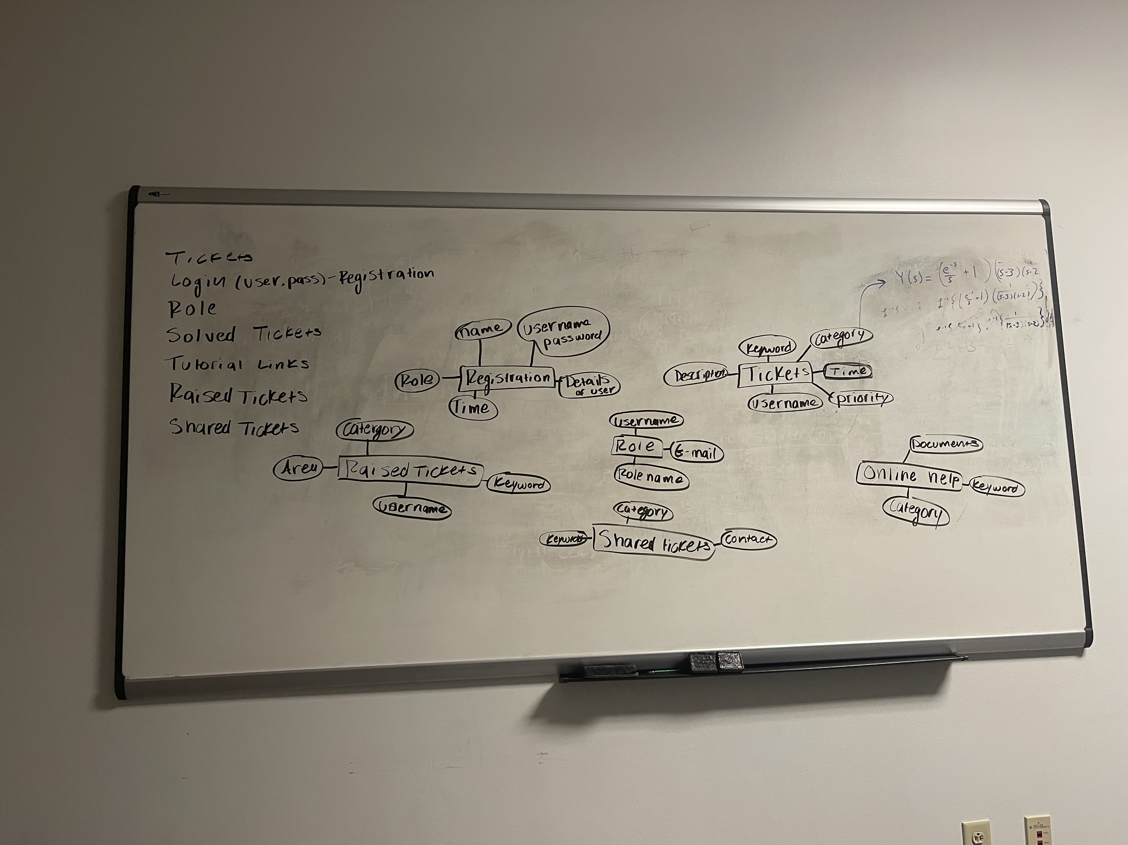
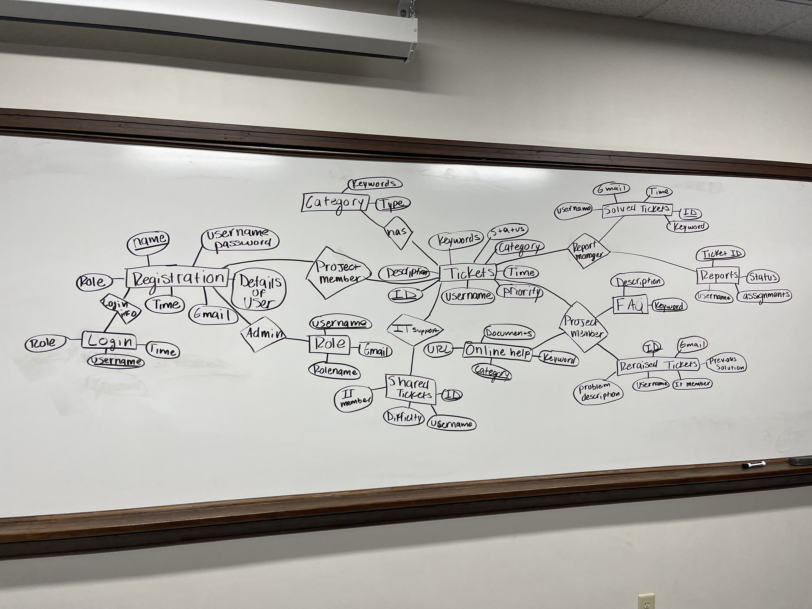
ER Diagrams

Slide 8
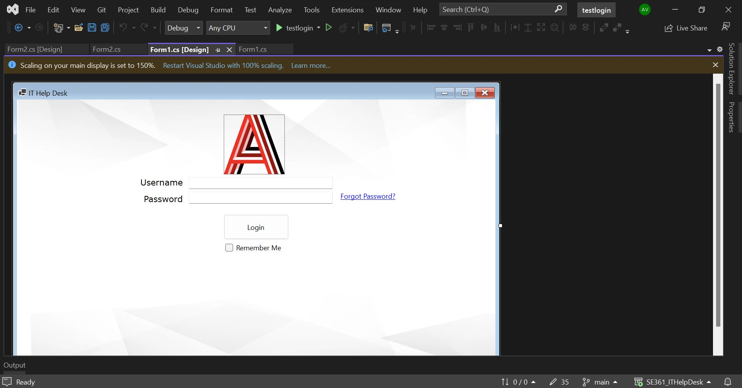
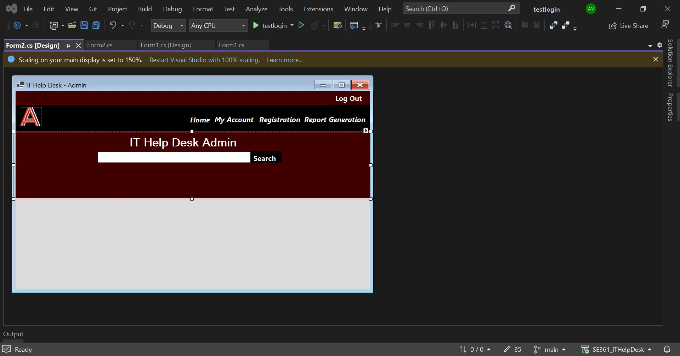
GUI Demo

Slide 9
Any Questions?
Thank you for listening to our presentation! :)

